Slide 1
Galatians 5:1-12
(English Standard Version)

Slide 2
5 For freedom Christ has set us free; stand firm therefore, and do not submit again to a yoke of slavery.
² Look: I, Paul, say to you that if you accept circumcision, Christ will be of no advantage to you. ³ I testify again to every man who accepts circumcision that he is obligated to keep the whole law. ⁴ You are severed from Christ, you who would be justified by the law; you have fallen away from grace. ⁵ For through the Spirit, by faith, we ourselves eagerly wait for the hope of righteousness. ⁶ For in Christ Jesus neither circumcision nor uncircumcision counts for anything, but only faith working through love.

Slide 3
⁷ You were running well. Who hindered you from obeying the truth? ⁸ This persuasion is not from him who calls you. ⁹ A little leaven leavens the whole lump. ¹⁰ I have confidence in the Lord that you will take no other view, and the one who is troubling you will bear the penalty, whoever he is. ¹¹ But if I, brothers, still preach circumcision, why am I still being persecuted? In that case the offense of the cross has been removed. ¹² I wish those who unsettle you would emasculate themselves!

Slide 4
The Offence of the Cross
1. The Gospel tells me “I am a Sinner in need of a Saviour”
Many live with the delusion “My good outweighs the bad – I don’t need a Saviour”
The Gospel demolishes every bit of ‘self-righteousness’.
In His love for us, God gave His only Son to die to save us from our sin.
2. The Gospel is Exclusive. Jesus Christ is our only means of salvation.
All are invited, but there is only one God to come to.
John 14: (ESV) ⁶ …. “I am the way, and the truth, and the life. No one comes to the Father except through me.

Slide 5
The Offence of the Cross
1. The Gospel tells me “I am a Sinner in need of a Saviour”
Many live with the delusion “My good outweighs the bad – I don’t need a Saviour”
The Gospel demolishes every bit of ‘self-righteousness’.
In His love for us, God gave His only Son to die to save us from our sin.
2. The Gospel is Exclusive. Jesus Christ is our only means of salvation.
All are invited, but there is only one God to come to.
3. Christ is Sufficient – Nothing else is needed
^{5:1} For freedom Christ has set us free; stand firm therefore, and do not submit again to a yoke of slavery.
No added works/religious practices required
False Teachers had told the Galatian Christians they needed to add Old Covenant Religious Practices to make their faith more complete...
Set free from Pagan worship of other Gods, but now being enslaved with Old Covenant Law

Slide 6
The Offence of the Cross
1. The Gospel tells me “I am a Sinner in need of a Saviour”
Many live with the delusion “My good outweighs the bad – I don’t need a Saviour”
The Gospel demolishes every bit of ‘self-righteousness’.
In His love for us, God gave His only Son to die to save us from our sin.
2. The Gospel is Exclusive. Jesus Christ is our only means of salvation.
All are invited, but there is only one God to come to.
3. Christ is Sufficient – Nothing else is needed
No added works/religious practices required
False Teachers had told the Galatian Christians they needed to add Old Covenant Religious Practices to make their faith more complete...
Set free from Pagan worship of other Gods, but now being enslaved with Old Covenant Law
It’s ‘a package deal’. If you feel you need some of the Law, obliged to keep it all
If I need some Law, Christ isn’t enough; Severed from Christ; Therefore must keep all Law
⁴ You are severed from Christ..... you have fallen away from grace.
⁵ For through the Spirit, by faith, we ourselves eagerly wait for the hope of righteousness. ⁶ For in Christ Jesus neither circumcision nor uncircumcision counts for anything, but only faith working through love.

Slide 7
The Offence of the Cross
1. The Gospel tells me “I am a Sinner in need of a Saviour”
Many live with the delusion “My good outweighs the bad – I don’t need a Saviour”
The Gospel demolishes every bit of ‘self-righteousness’
2. The Gospel is Exclusive. Jesus Christ is our only means of salvation.
All are invited, but there is only one God to come to.
3. Christ is Sufficient – Nothing else is needed
No added works/religious practices required
False Teachers had told the Galatian Christians they needed to add Old Covenant Religious Practices to make their faith more complete...
Set free from Pagan worship of other Gods, but now being enslaved with Old Covenant Law
It’s ‘a package deal’. If you feel you need some of the Law, obliged to keep it all
Jew or Gentile (circ. / uncirc.) doesn’t matter
but only faith working through love.
Faith has to be connected with Love: Love from God; Love for God.
⁷ You were running well. Who hindered you from obeying the truth?

Slide 8
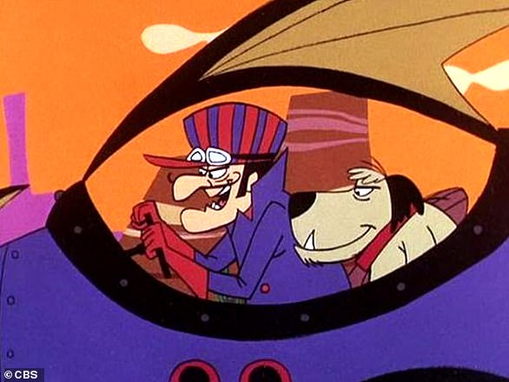
⁷ You were running well. Who hindered you from obeying the truth?

Slide 10
⁷ You were running well. Who hindered you from obeying the truth?

Slide 11
The Offence of the Cross
1. The Gospel tells me “I am a Sinner in need of a Saviour”
Many live with the delusion “My good outweighs the bad – I don’t need a Saviour”
The Gospel demolishes every bit of ‘self-righteousness’
2. The Gospel is Exclusive. Jesus Christ is our only means of salvation.
All are invited, but there is only one God to come to.
3. Christ is Sufficient – Nothing else is needed
No added works/religious practices required
False Teachers had told the Galatian Christians they needed to add Old Covenant Religious Practices to make their faith more complete...
Set free from Pagan worship of other Gods, but now being enslaved with Old Covenant Law
It’s ‘a package deal’. If you feel you need some of the Law, obliged to keep it all
Jew or Gentile (circ. / uncirc.) doesn’t matter
but only faith working through love.
Faith has to be connected with Love: Love from God; Love for God.
⁷ You were running well. Who hindered you from obeying the truth? ⁸ This persuasion is not from Him who calls you.
Teachings that distract from the Gospel (even from persuasive teachers) are not of God.
All such distractions and corruptions of the Gospel are to be rooted out of the church
¹⁰ I have confidence in the Lord that you will take no other view, and the one who is troubling you will bear the penalty, whoever he is.

